Slide 1
2D Curve reconstruction
Group 1:
Arjan van den Boogaart
Wilco Brouwer
Chris Mens
Martijn Muijsers
Rob Wu

Slide 2
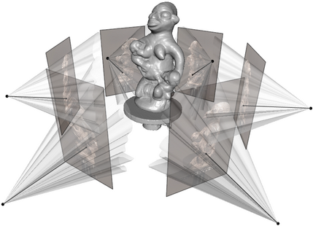
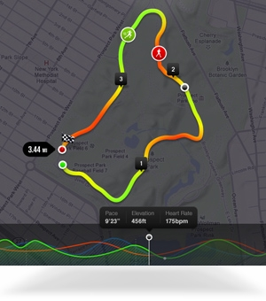
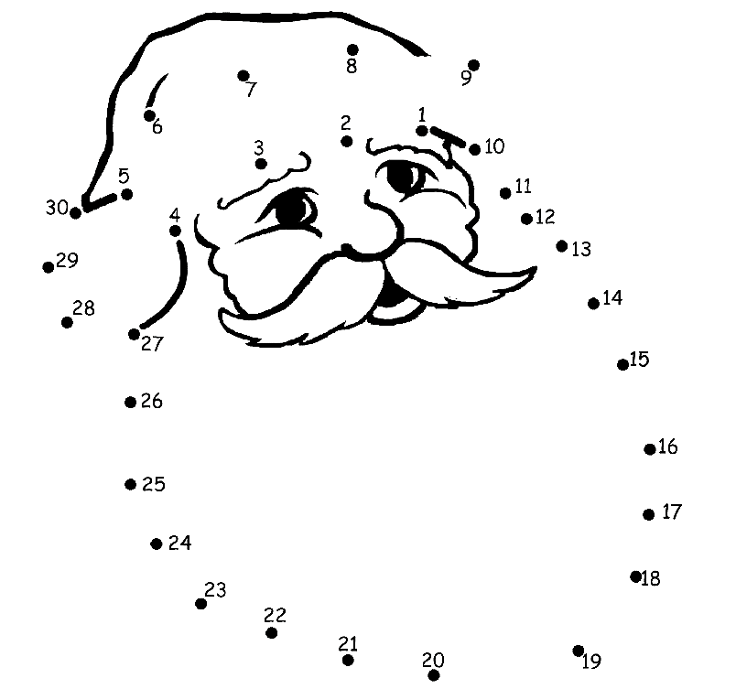
Problem Introduction
Single curve reconstruction
Multiple curves reconstruction
Network reconstruction
http://carlos-hernandez.org/images/3dmodeling1.png
Source: Nike+ ®
Source: http://kids.flevoland.to/puzzel/punten-kerstman.shtml

Slide 3
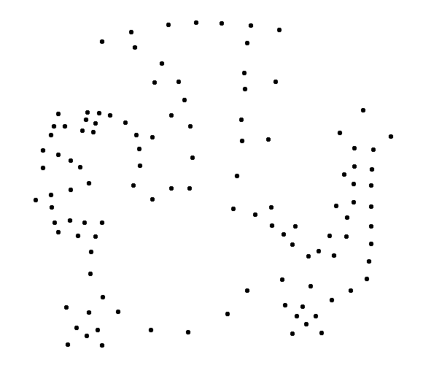
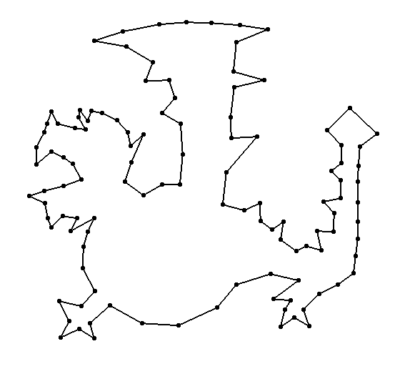
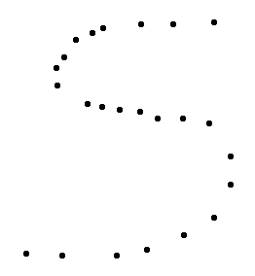
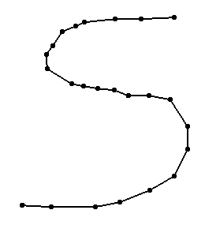
Problem Description
Single closed curve reconstruction
Single open curve reconstruction

Slide 4
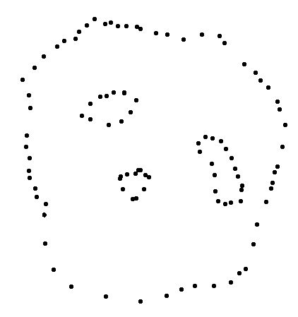
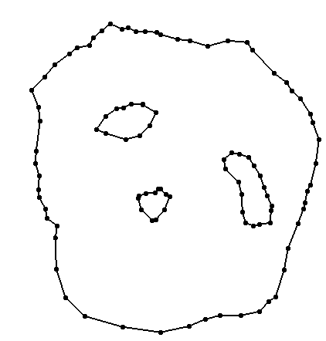
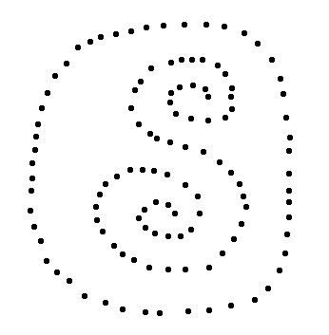
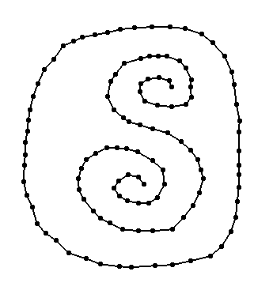
Problem Description
Multiple curves reconstruction

Slide 5
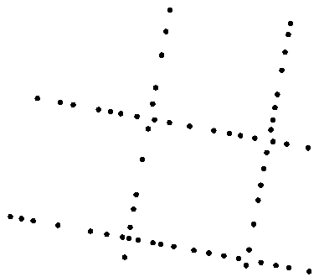
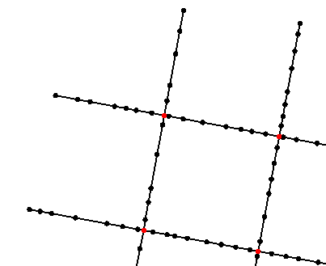
Problem Description
Network reconstruction

Slide 6
Single curve reconstruction
Construct convex hull
Reconstruct a closed curve
Decide between open or closed curve

Slide 7
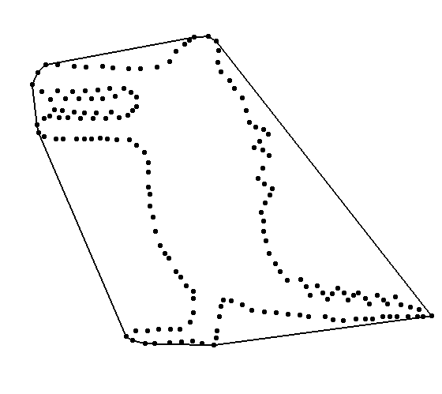
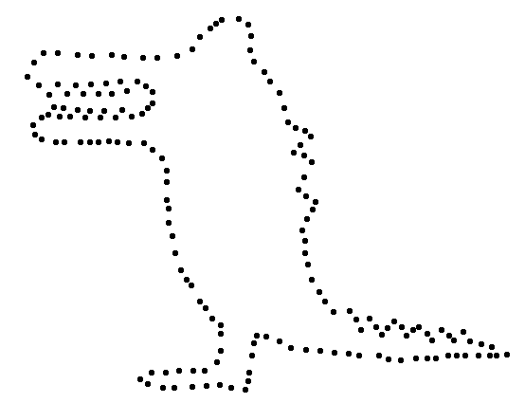
Single curve reconstruction
Construct convex hull

Slide 8
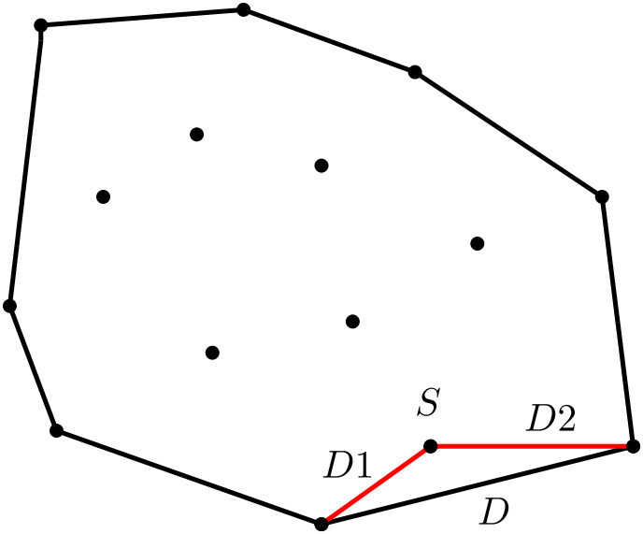
Single curve reconstruction
Initialize
For each unconnected node S
  Store for each segment the weight
  Where weight = D / (D1 + D2)

Slide 9
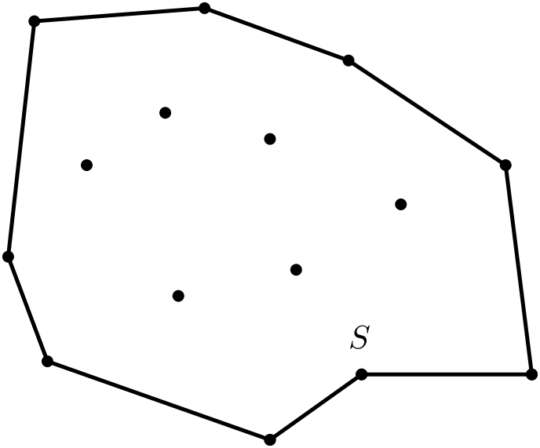
Single curve reconstruction
Process
For each unconnected node
  Connect the node to the two nodes of the segment with the highest weight
  Check for intersection
  Update the data

Slide 10
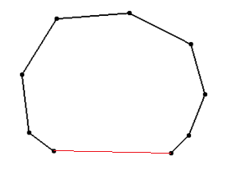
Single curve reconstruction
Decide between open and closed curve
Sort the segment lengths and check for one abnormal segment length.

Slide 11
Single curve example

Slide 12
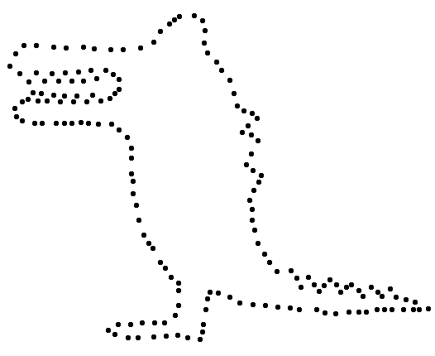
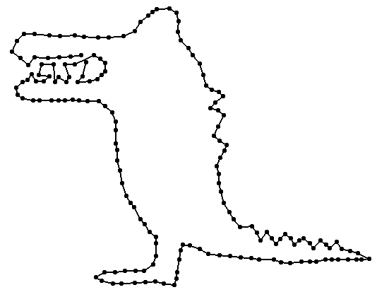
Single curve example imperfection

Slide 13
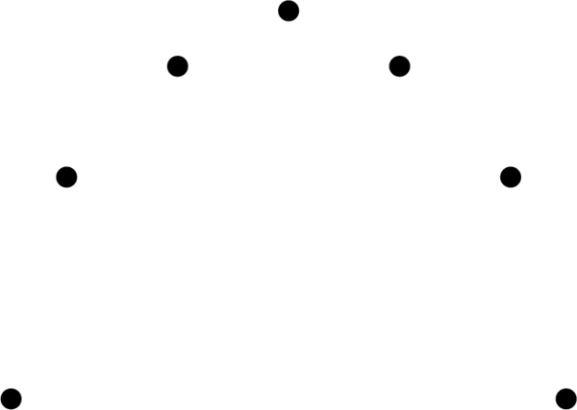
Multiple curves: Input

Slide 14
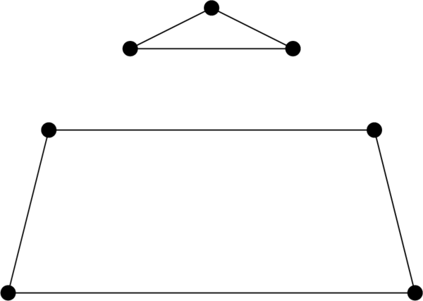
Multiple curves: Initial connections

Slide 15
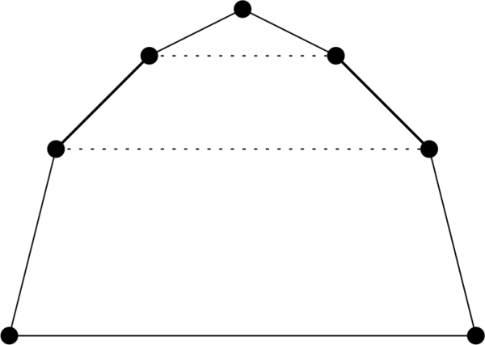
Multiple curves: Fix sharp corners

Slide 16
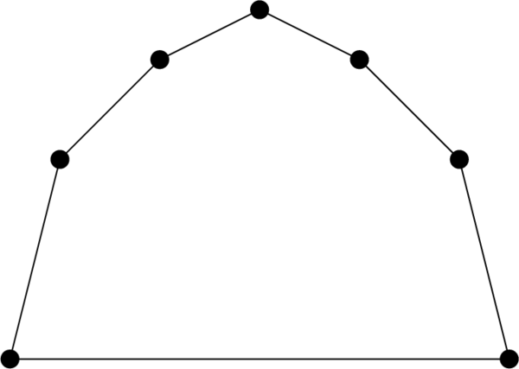
Multiple curves: Fix sharp corners

Slide 17
Multiple curves: Running time
n = number of nodes
Initial connections = n² log n
  Construct baseline: n²
  Sort input by length: n² log n
  Select edges: n²
Fix corners
  Check neighbors of nodes for all segments: n^{2.}

Slide 18
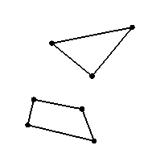
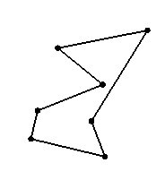
Multiple curves: Experimental evaluation
  Works well in general
  Oblivious to context.
  Long lines

Slide 19
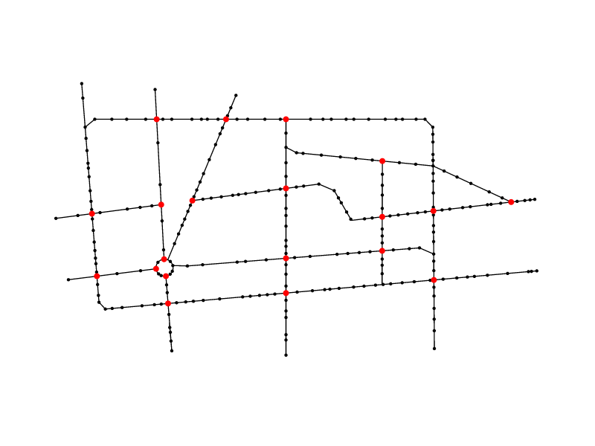
Network reconstruction

Slide 20
Network reconstruction steps
  Create a MST from the set of given points
  Connect endpoints
  Remove divergent segments
  Add new segments and points where necessary

Slide 21
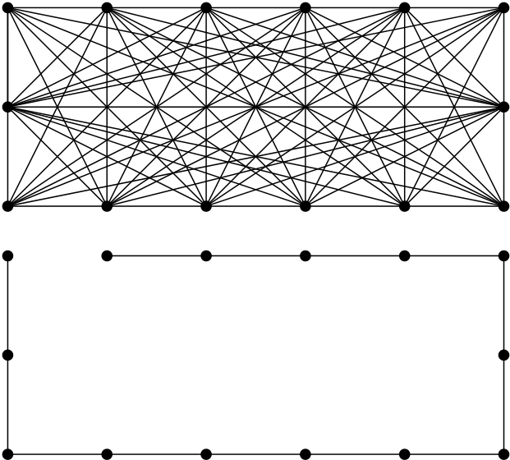
Create the MST
  Kruskal’s Algorithm

Slide 22
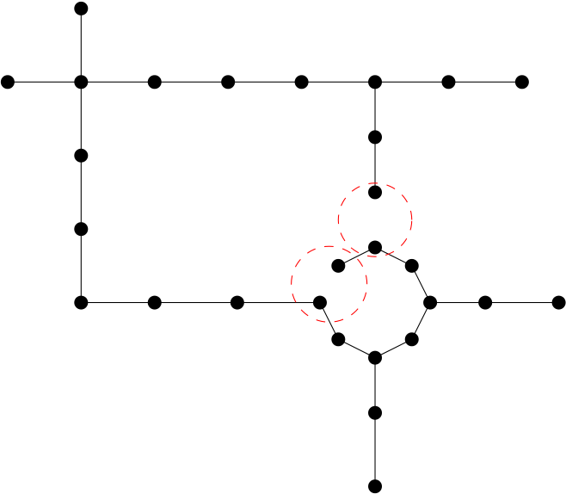
Connect endpoints
  Construct adjacency matrix
  Look for nearby nodes and check direction

Slide 23
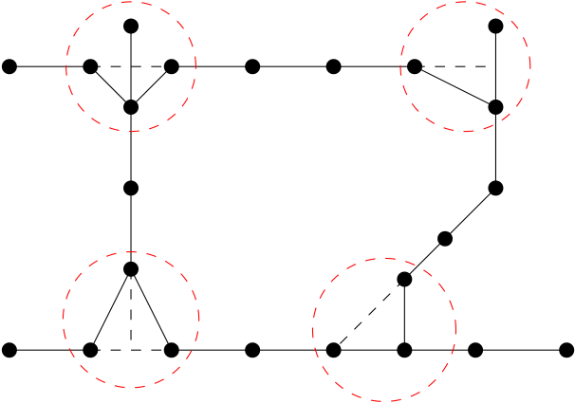
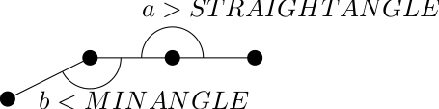
Remove divergent segments
  Locate divergent segments
  Remove if needed

Slide 24
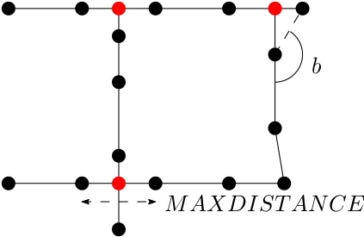
Add new segments
  Find endpoints
  Look for nearby point or intersecting segment
  Create new segment and/or point

Slide 25
Running time analysis
  Create a MST O(n² log n)
  Connect endpoints O(n)
  Remove divergent segments O(n)
  Add new segments and points O(n)
  O(n² log n)

Slide 26
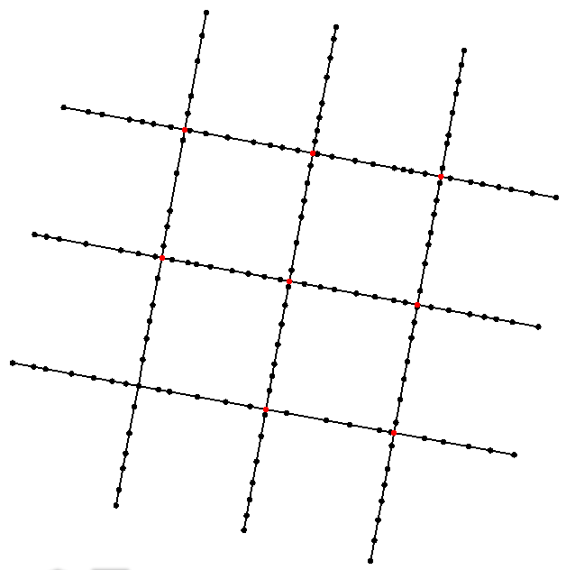
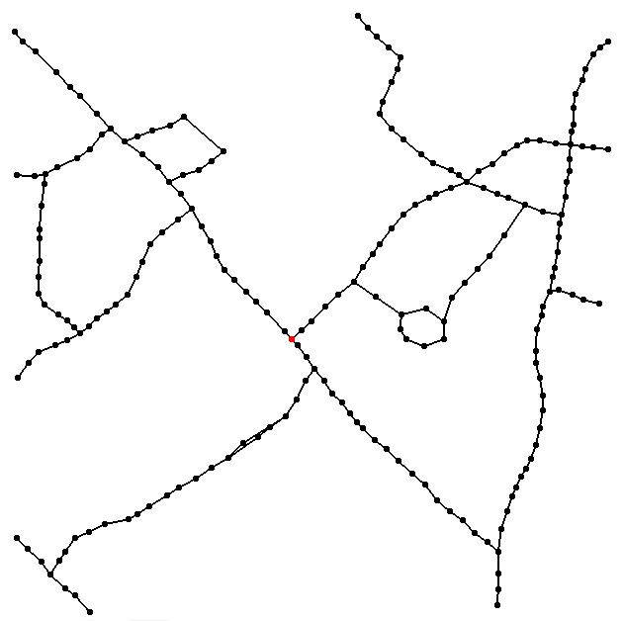
Experimental evaluation
  MAXDISTANCE = 0.1f
  MINANGLE = 160
  STRAIGHTANGLE = 165

Slide 27
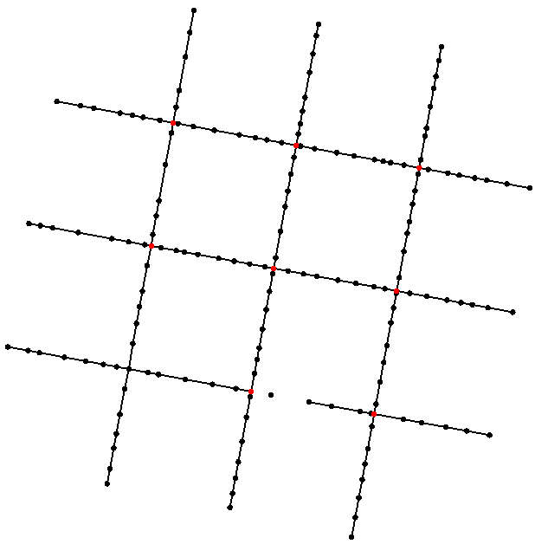
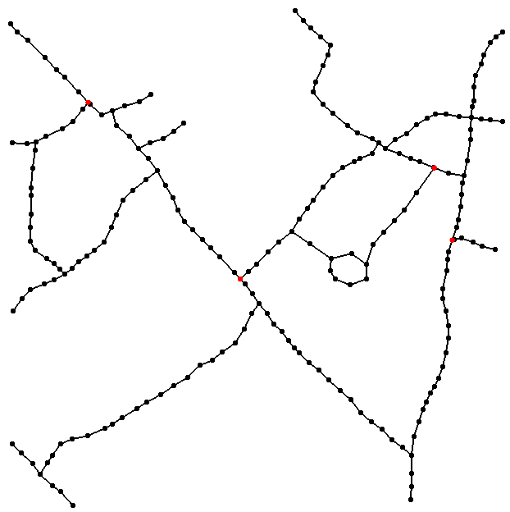
Experimental evaluation
  MAXDISTANCE = 0.07f
  MINANGLE = 165
  STRAIGHTANGLE = 170

